Slide 1
Milestone 1
Group QuantumBlack
Mar 1 2022

Slide 2
Table of contents
Problem statement, Motivation & Background
Scope of Work, Relevant knowledge & Literature review
Summary of Team and Collaboration Infrastructure
Data Processing
USDM
Satellite Images
SET
SMAP
Summary and Next Step

Slide 3
Problem statement
Problem statement:
A machine learning model for long-term drought prediction in the continental U.S.
Motivation & Background:
Drought is by far the most costly natural disaster that can lead to widespread impacts

Slide 4
Scope of Work
Not focusing on:
Short term weather forecasting
We are focusing on:
Long term/intertemporal drought prediction
Notes:
Shorten the not focusing part in MS1 document

Slide 5
Relevant knowledge & Literature review
What justifies our black box machine learning model?
Drought:
Complex causal mechanisms and ambiguous signals
Ault (Science, 2020), On the essentials of drought in a changing climate
Long term weather prediction:
No reliable approach as been developed
Livneh (Nature, 2020), Drought less predictable under declining future snowpack

Slide 6
Team and Work Structure
 | Intro & Literature | Data | Model* | Misc.
Yujie | Assist | Owner | Owner | Communication with Partner
Michael | Assist | Owner | Owner | Documentation
Jim | Owner | Owner | Owner | Documentation
Thee | / | Owner | Owner | Github
Each member alternatively lead weekly meetings and partner meetings
*tentative plan
Notes:
Working together, because too much sources 1min

Slide 7

Data List
2012(?)-2022, In weeks, by county
Drought risk
Climate + Satellite predictors for one loc
Name | Category | Feature | Format | Transformation | Prog.
USDM | Y & X | Drought risk | Numbers | WSum, Sampling | Samp2
SET | X | Evaporation, Runoff | Numbers, by coordinates | Match fips | Geo
SMAP | X | Soil moisture map | Map in days, by county | Averaging days, match week | Time
Satellite | X | Satellite images | Images, by coordinates | Comes in week, match fips | Geo
Notes:
40s, probably in this time range because data availability, and try to achieve more data. 531 weeks. mention the model, and progress.

Slide 8
USDM Data
Sampling idea #1: （Current)
RANDOM random sampling
Get 300 (~1/10) counties
Obtain the whole time series
Issue: fairness? representative?
Sampling idea #2:
STRATIFIED random sampling
9 climate regions in CONUS
Get 50 (~13.8%) counties from each
Obtain the whole time series
Notes:
20s

Slide 9
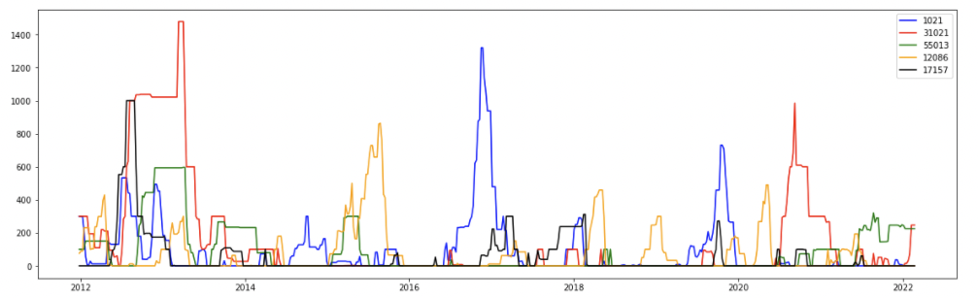
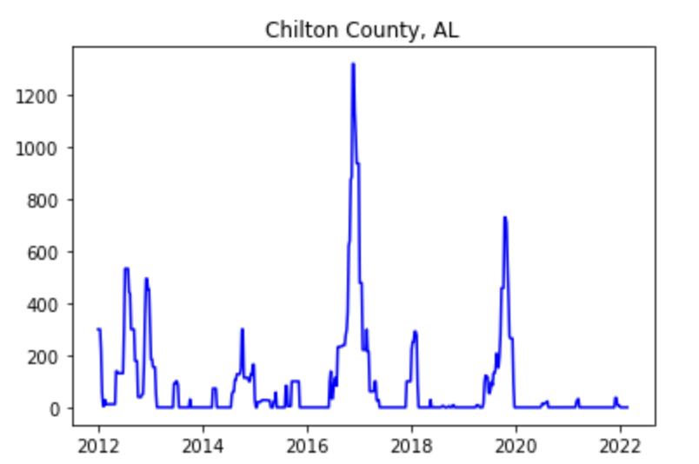
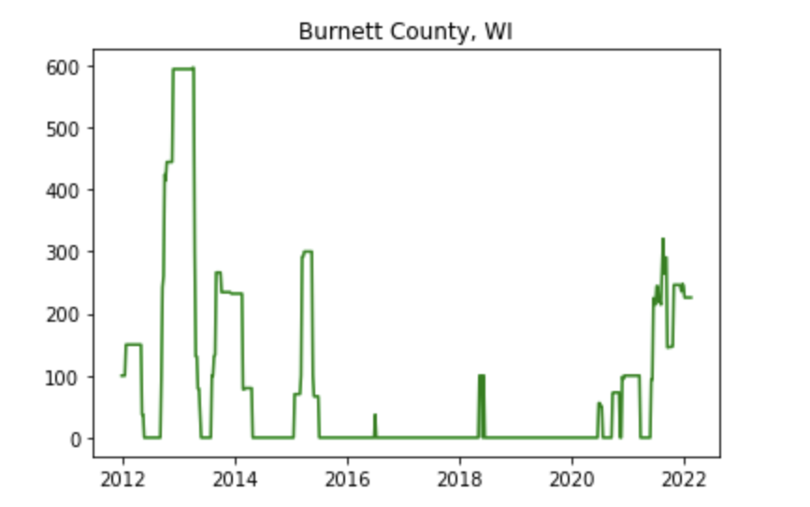
USDM Data
Drought Intensity over Time (2012-2022, five counties)
Weighted sum of Drought index level
W.Sum
W.Sum
Notes:
20s

Slide 10
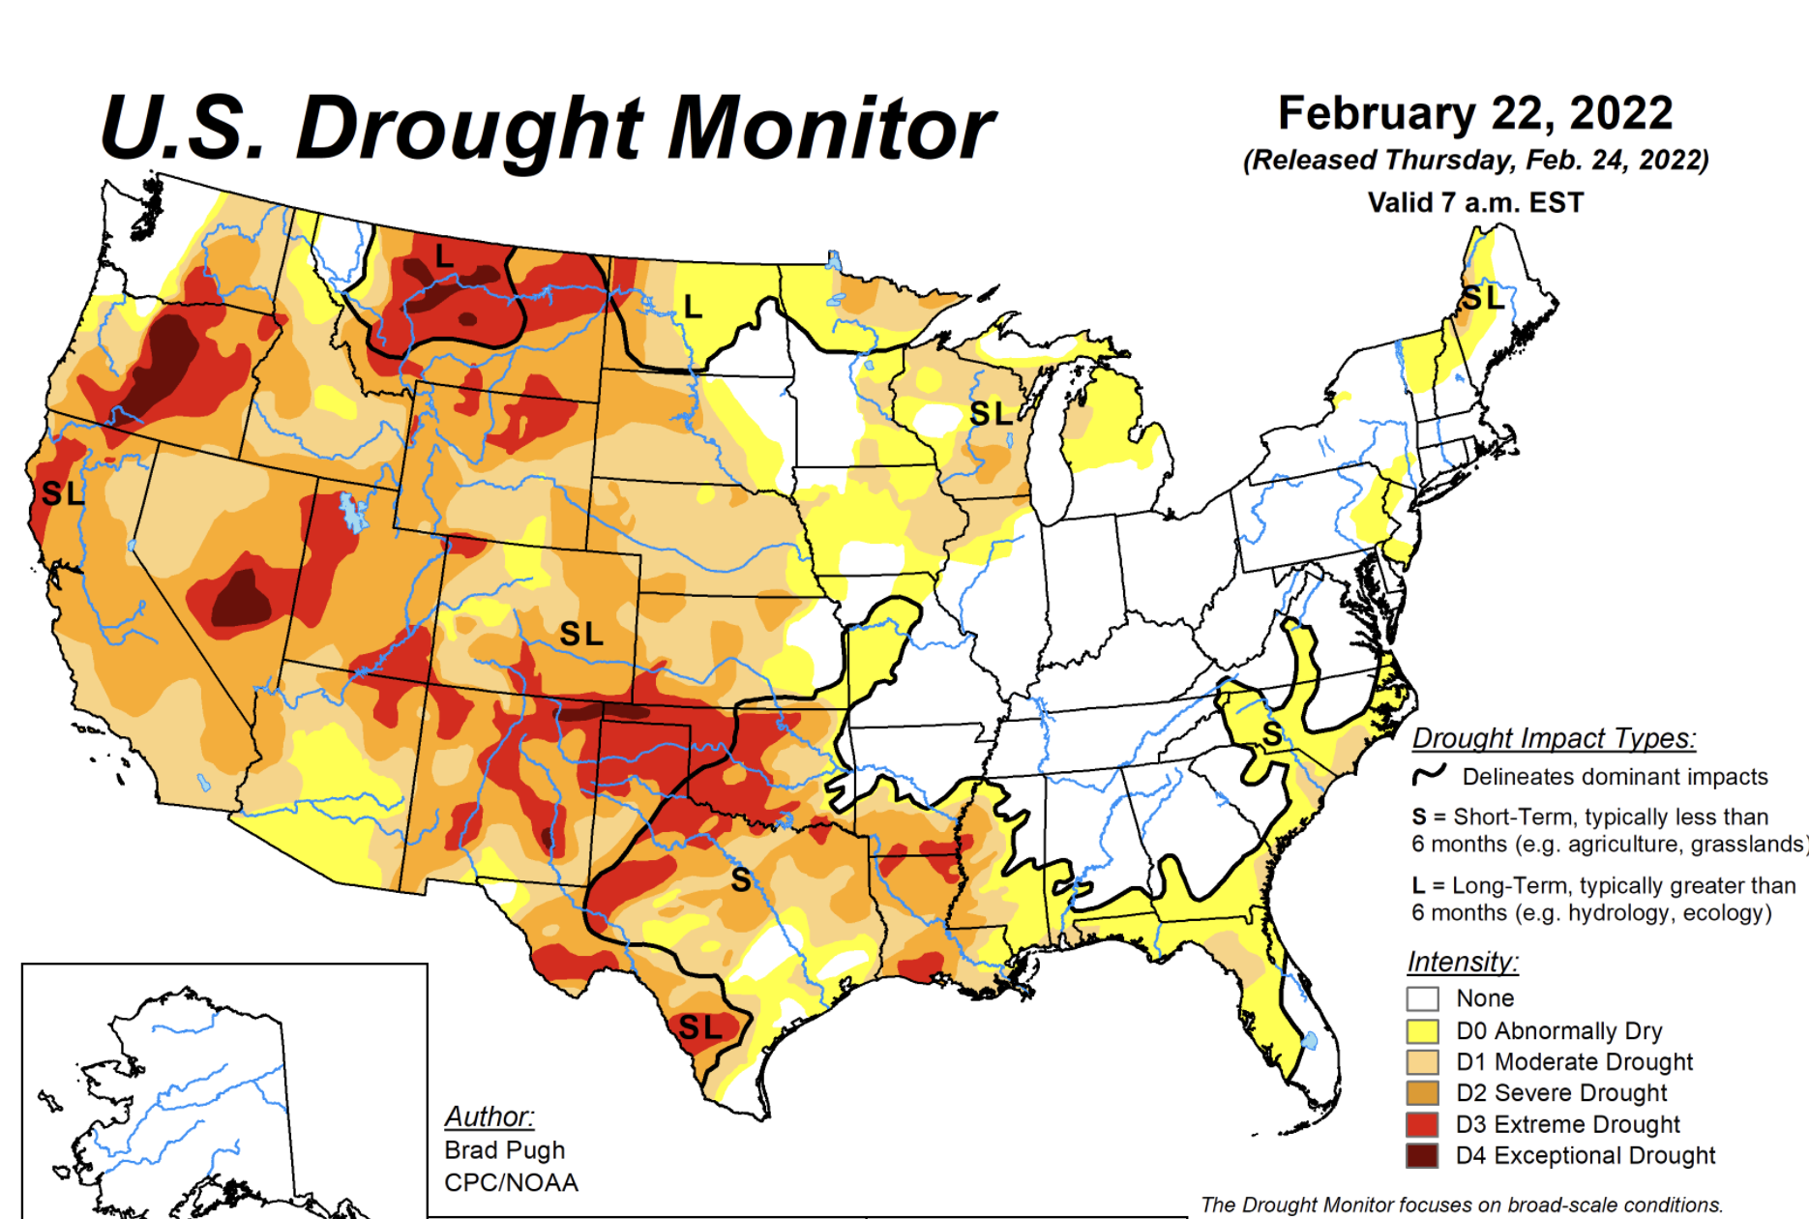
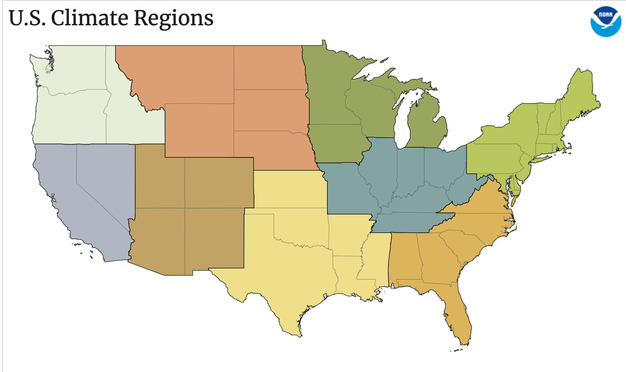
USDM Data
32(10.7%)
11(3.7%)
27(9%)
24(8%)
62(20.7%)
5(1.7%)
12(4%)
64(21.3%)
63(21%)
Observation: lots of the data are concentrated in southeast U.S. but these area are NOT quite associated with drought.
Notes:
30s

Slide 11
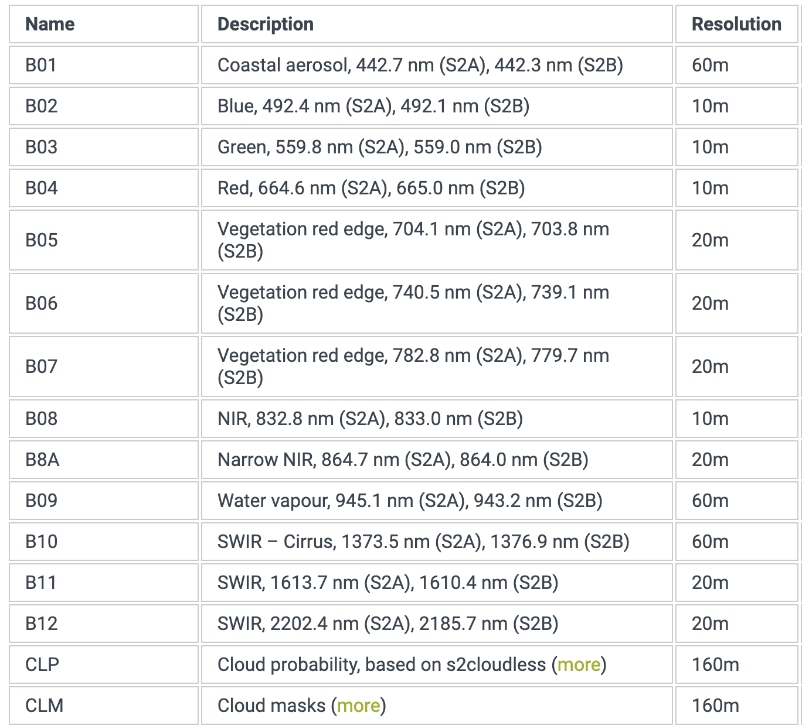
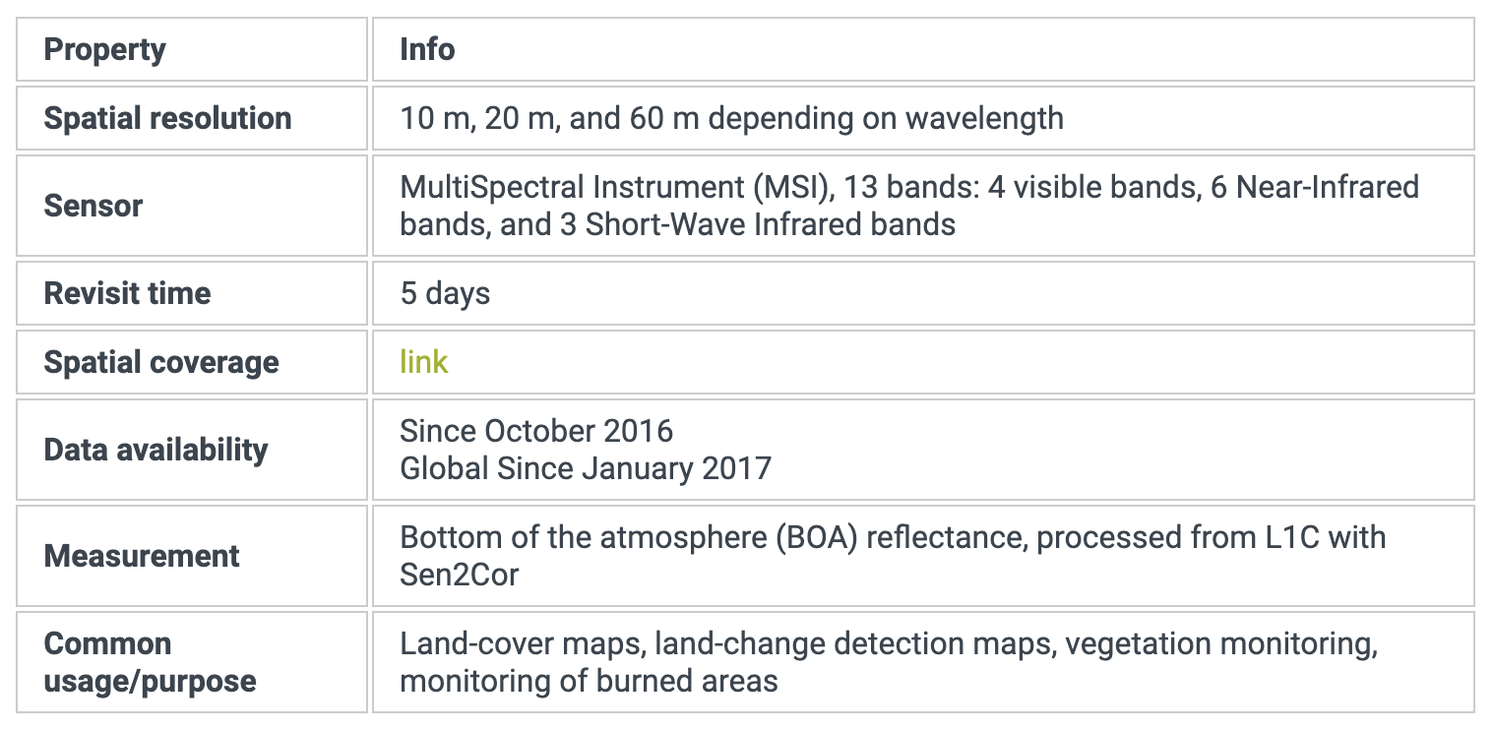
Sentinel Hub Satellite Image: Sentinel-2 L2A
Notes:
Contains satellite images globally since 2017, the satellite is revisiting every 5 days.
The resolution of as small as 10-60 meter.
Each pixel comes with 13 bands.

Slide 12
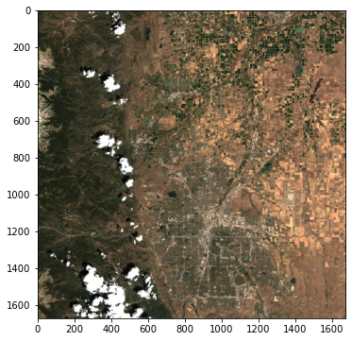
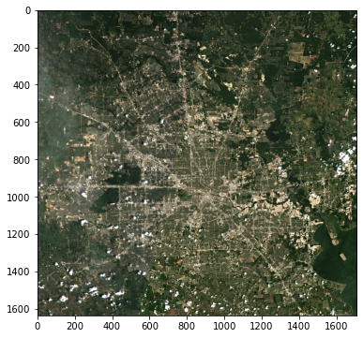
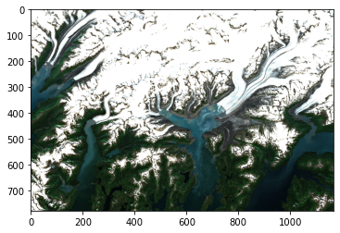
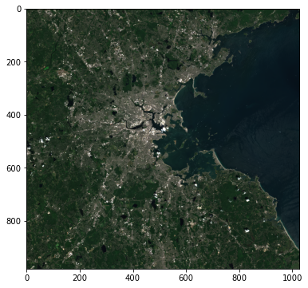
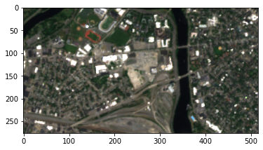
Sentinel-2 L2A
Broomfield, CO 2020-07-15 to 2020-07-20
Harris, TX 2020-07-15 to 2020-07-20
Alaska 2020-07-15 to 2020-07-20
Suffolk, MA 2020-07-15 to 2020-07-20
SEC Harvard 2020-07-15 to 2020-07-20
Notes:
API to specify lat/lon and time period and will return a single image. Their algorithm already pre-process the image
We wrote a function that takes in a county name and state and dimension that we want and return an image
Still, in certain area and certain time period with lengthy period of cloud or bad climate,

Slide 13
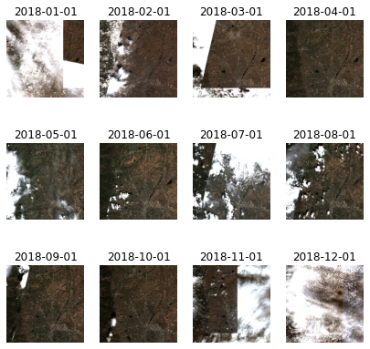
Sentinel-2 L2A: Time-series
Broomfield, CO: Monthly data 2018 to 2019
Notes:
Handling large number of counties and weekly timestamps
Notice that even though these images were already pre-processed, some of them still show inconsistent brightness and cloud coverage, strange way of patching.
Our future work will include spending a lot of time pre-processing these images: removing the area with cloud and normalizing brightness as well as consult with the domain experts on which feature we should extract from these images that are related to the risk of drought.

Slide 14
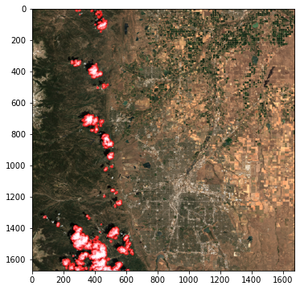
Sentinel-2 L2A: Cloud detection
Without cloud detection
With cloud detection
Notes:
The image also comes with cloud probability and cloud mask band, so we can use them to detect cloud coverage in the images.
Request limit which we will need to create multiple account or discuss with our partners if they are willing to support

Slide 15
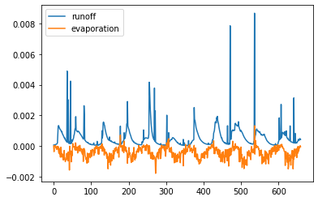
SET Data
Evaporation from top soil measured in periods since 2011
Measured as change in water height in evaporimeter
Runoff in topsoil since measured in periods since 2011
Measured as depth of water accumulated in meters
Notes:
Evaporation (Up): The amount of evaporation from bare soil at the top of the land surface. This variable is accumulated from the beginning of the forecast time to the end of the forecast step.
Runoff (Down): Some water from rainfall, melting snow, or deep in the soil, stays stored in the soil. Otherwise, the water drains away, either over the surface (surface runoff), or under the ground (sub-surface runoff) and the sum of these two is simply called 'runoff'. This variable is the total amount of water accumulated from the beginning of the forecast time to the end of the forecast step. The units of runoff are depth in metres.

Slide 16
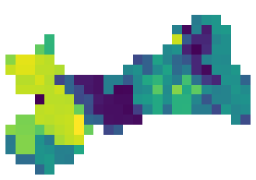
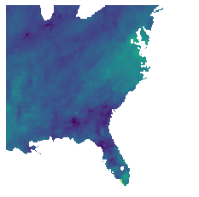
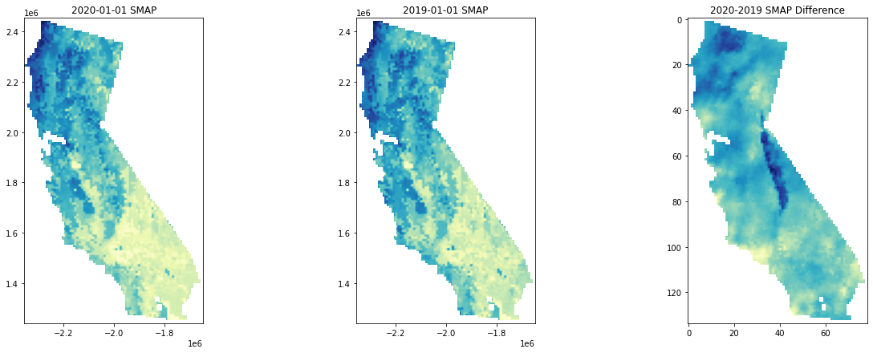
SMAP Data
SE CONUS Region
Fresno, CA
Notes:
There is abnormality map that shows significant change from historical based on given formula
Can demonstrate change over time across certain regions of US down to county level
Also have shape files used in GIS applications which we might be able to use to more accurately map satellite images to counties

Slide 17
Current Step Summary
Progress
Data processing
Datasets accessed, accounts created, samples sourced
Splicing data together has begun
Flushed out first step of literature review
Obstacles
Finding proper actionable variables as independent variables, in corresponding time and scale
E.g. Urbanization, land usage, greenhouse gases
Splicing together different types of data as features
Bad request on satellite data as well as mapping of satellite data to counties
Masking of satellite data
Notes:
30s

Slide 18
Next Step
Data
Finishing up data processing next week, before spring recess
Downloading applicable data sources
Potentially storing data on AWS buckets for easy access
Model
Baseline statistical model: time series on Y itself
Simple time series?? Start from 1-week, 2-week, 4-week etc..
Feature analysis
Advanced model:
#1：time series with multiple X variables
#2：with satellite images
#3: neural network type of approach (such as predicting SMAP values from satellite images with GAN like Pix2Pix)
Notes:
20s

Slide 19
THANK YOU!

